Slide 1
Binomial Coefficients
Section 5.4

Slide 2
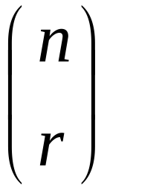
Binomial Coefficients
This number represents the binomial coefficient:
Why? Because these numbers occur as coefficients in the expansion of powers of binomial expression such as (a+b)^{n}

Slide 3
Example
(x+y)⁰ = 1
(x+y)¹ = x + y
(x+y)² = x² + 2xy + y²
(x+y)³ = x³ + 3x²y + 3xy² + y³
(x+y)⁴ = x⁴ + 4x³y + 6x²y² + 4xy³ + y⁴

Slide 4
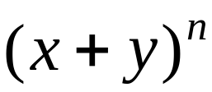
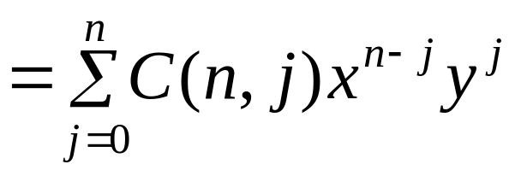
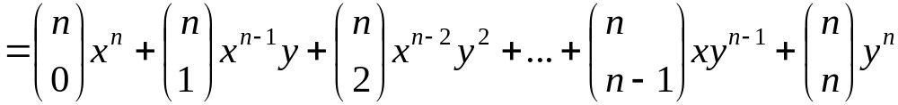
Binomial Theorem
Gives the coefficients of the expansion of powers of binomial expressions.
Let x ∈ R, y ∈ R, and n ∈ N.

Slide 5
Example
Expand (x+y)⁵.
What is the coefficient of x¹²y¹³ in the expansion of (x+y)²⁵ ?
What is the coefficient of x¹²y¹³ in the expansion of (2x-3y)²⁵ ?

Slide 6
Pascal’s Triangle
Geometric arrangement of binomial coefficients
Based on Pascal’s Identity
Draw a Pascal’s Triangle with 6 rows

Slide 7
Pascal’s Identity
Let n ∈ Z⁺ and k ∈ Z⁺ with n ≥ k. Then,
  C(n+1, k) = C(n, k−1) + C(n, k)
When two adjacent binomial coefficients in this Pascal’s triangle are added, the binomial coefficient in the next row between these two coefficients is produced.
C(7,5)=C(6,4)+C(6,5)

